Slide 1
Assignment 3
Deadline April 5, 2017

Slide 2
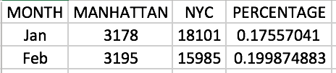
Nyc vehicle collision analysis
Q1_Part one
Use ‘vehicle_collisions’ data set.
For each month in 2016, find out the percentage of collisions in Manhattan out of that year's total accidents in New York City.
Display a few rows of the output use df.head().
Generate a csv output with four columns (‘Month’, ‘Manhattan’, ‘NYC’, ‘Percentage’)
Example output:

Slide 3
Nyc vehicle collision analysis
Q1_Part Two
Use ‘vehicle_collisions’ data set.
For each borough, find out distribution of each collision scale. (One car involved? Two? Three? or more?) (From 2015 to present)
Display a few rows of the output use df.head().
Generate a csv output with five columns ('borough', 'one-vehicle', 'two-vehicles', 'three-vehicles', 'more-vehicles')
Example output:

Slide 4
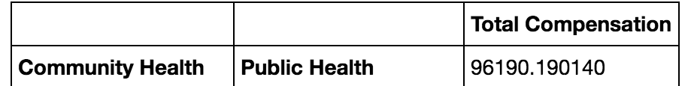
Employee Compensation analysis
Q2_PART ONE
Use 'employee_compensation' data set.
Find out the highest paid departments in each organization group by calculating mean of total compensation for every department.
Output should contain the organization group and the departments in each organization group with the total compensation from highest to lowest value.
Display a few rows of the output use df.head().
Generate a csv output.
Example output:

Slide 5

Employee Compensation analysis
Q2_Part Two
Use 'employee_compensation' data set.
Find the people whose overtime salary is greater than 5% of salaries (salaries refers to ’Salaries' column)
For each job family these people are associated with (job family refers to ’Job Family' column), calculate what is the percentage of total benefits with respect to total compensation (so for each job family you have to calculate average total benefits and average total compensation). Create a new column (Percent_total_benefit) which has the percentage value.
Display the top 5 job families according to Percent_total_benefit using df.head().
Write the output (jobs and Percent_total_benefit) to a csv.
Example output:

Slide 6

Cricket Matches analysis
Q3_PART ONE
Use ‘cricket_matches’ data set.
In this analysis, you are supposed to calculate the average score for each team which host the game and win the game.
Remember that if a team hosts a game and wins the game, their score can be innings_1 runs or innings_2 runs. You have to check if the host team won the game, check which innings they played in (innings_1 or innings_2), and take the runs scored in that innings. The final answer is the average score of each team satisfying the above condition.
Display a few rows of the output use df.head()
Generate a csv output
Example output:

Slide 7
Movie awards analysis
Q4_part one
Use ‘movies_awards’ data set.
You are supposed to extract data from the awards column in this dataset and split it into several columns. An example is given below.
The awards has details of wins, nominations in general and also wins and nominations in certain categories(e.g. Oscar, BAFTA etc.)
You are supposed to create a win and nominated column (these 2 columns contain total number of wins and nominations) and other columns that extract the number of wins and nominations for each category of award.
If a movie has 2 Oscar nominations and 4 Oscar won, the columns Oscar_Awards_Won should have value 4 and Oscar_Awards_Nominated should have value 2. You should also have a total won and nominated column which aggregates all the awards (won or nominated).
Create two separate columns for each award category (won and nominated).
Write your output to a csv file. (Sample output is given in next page)

Slide 8
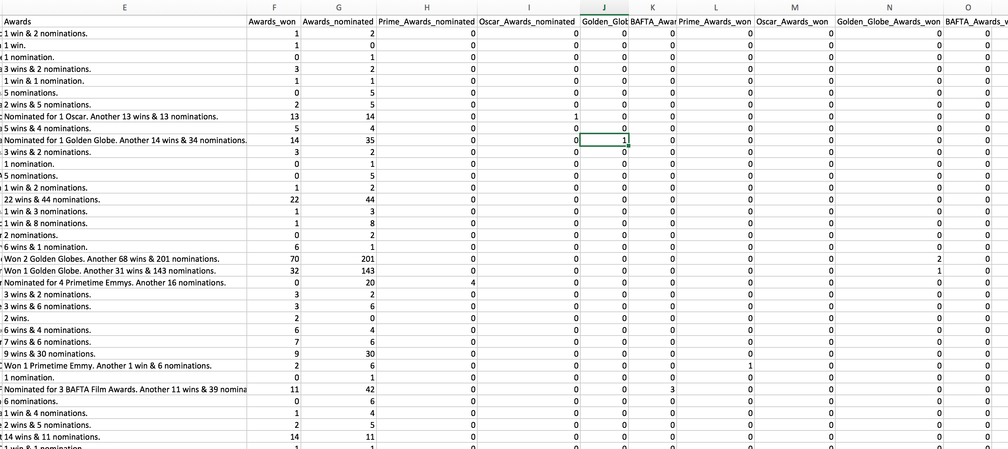
Sample output for Q4

Slide 9
Before you submit, please check below !!!
You MUST use pandas DataFrame to process your work.
Please create a new file for each of the question. You should have SIX code files.
You have to generate one csv file for each question. You should have SIX csv files. And your output csv file MUST be similar as the given example.
You need to print some proper output in your code by using df.head().
You have to write proper comments for each question.
Please use relative path to read csv files.
Your submissions are suppose to be as .py files. [No .ipynb files are acceptable] and your file names should have the question and part number (e.g. Q1_Part_1)
Your submissions should be executable without any errors.
No submission after the deadline will be evaluated.

